Slide 1
Geographically Weighted Regression
The Concept of Local Spatial Regression

Slide 2
We Have Covered:
OLS Regression
Assumes that observations (and residuals) are independent, which rarely happens with geographic (spatially autocorrelated) data
Spatial Lag Regression
Assumes that the spatial autocorrelation in the OLS residuals can be accounted for by including the spatial lag of the dependent variable as a predictor in the regression.
Spatial Error Regression
Assumes that the spatial autocorrelation in the OLS residuals is due to a missing spatial variable, and includes a spatially weighted error term as a predictor in the regression

Slide 3
But…
All these methods assume that we’re dealing with spatial stationarity
Spatial stationarity: assumption that modeled relationships are constant across space.
E.g.: The relationship between median house value and crime will be the same in different parts of Philadelphia
Necessary assumption, but likely not true in practice
What if we acknowledge that we’re dealing with spatial non-stationarity?

Slide 4
Said Differently…
What if instead of having a single, global, regression, we have separate, local, regressions for each location (point, block group, tract, zip code, etc.)?
For instance, higher home values might be correlated with higher burglary rates in some locations and lower burglary rates in some others
In some areas which are poor and have low house values, burglary might be high due (partially) to the fact that the police department in that area is likely to concentrate on more serious crimes that take place there and not so much on the “commonplace” events like burglary, meaning that burglars are more likely to walk.
In some areas which are rich and have high house values, burglary might be high due to the fact that burglars may believe they’re more likely to find valuable things to steal.
This is what Geographically Weighted Regression (GWR), a method proposed by S. Fotheringham, does!

Slide 5
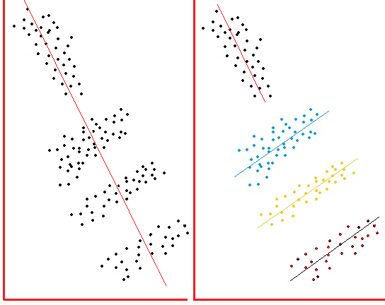
Simpson’s Paradox
# Burglaries # Burglaries
Plot on the left:
If you look at ALL block groups in Philadelphia # Burglaries and Median House Value are inversely related.
Plot on the right:
If you disaggregate the data and look at data by region (e.g., North, West, South, and Northeast Philly), you might see that there are different relationships between the two variables in different areas.
Median House Value
Median House Value

Slide 6

Source: www.causeweb.com

Slide 7
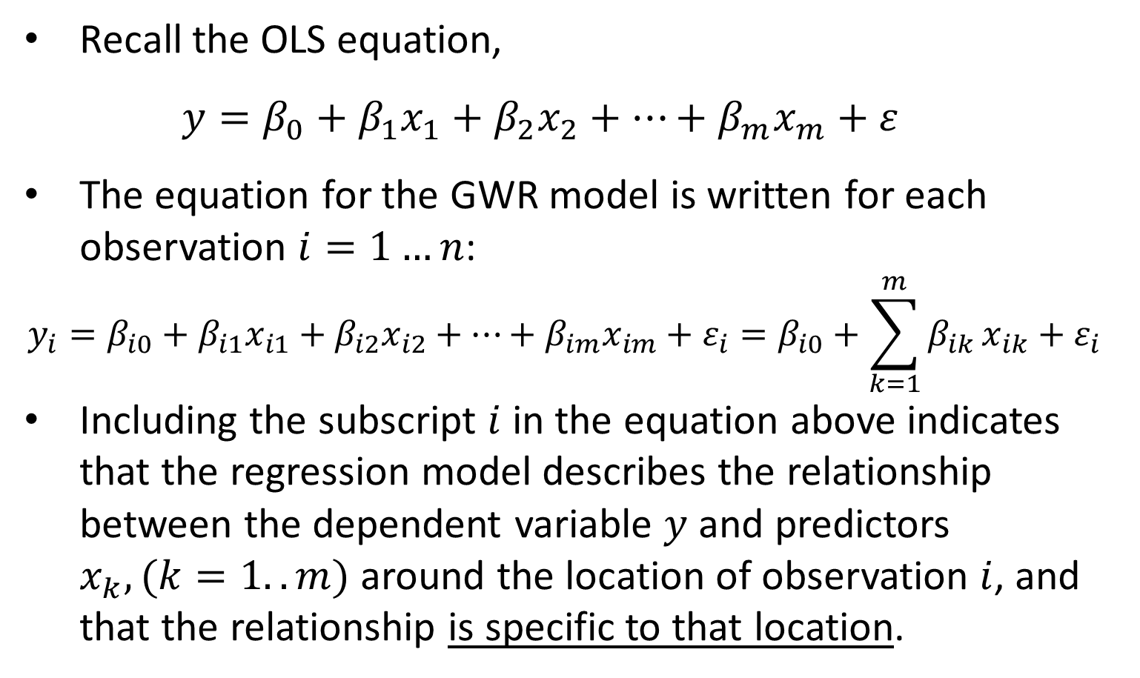
Mathematically Speaking…
Recall the OLS equation,
$$y=β_{0}+β_{1}x_{1}+β_{2}x_{2}+…+β_{m}x_{m}+ε$$
The equation for the GWR model is written for each observation $i=1…n$:
$$y_{i}=β_{i0}+β_{i1}x_{i1}+β_{i2}x_{i2}+…+β_{im}x_{im}+ε_{i}=β_{i0}+\sum_{k=1}^{m}{β_{ik}}x_{ik}+ε_{i}$$
Including the subscript $i$ in the equation above indicates that the regression model describes the relationship between the dependent variable $y$ and predictors $x_{k}, (k=1..m)$ around the location of observation $i$, and that the relationship is specific to that location.
Source: http://www.geos.ed.ac.uk/~gisteac/fspat/gwr/arcgis_gwr/GWR_WhitePaper.pdf

Slide 8
But How Is Local Regression Run?
That is, how do you run a regression for each location?
You need multiple observations (locations) to run a regression, not just a single observation (location) i !
GWR uses other observations in the dataset to run the regression; observations that are close to location i are given greater weights.
The weight of an observation varies with location i
Observations closer to i have a stronger influence on the estimation of the parameters for location i.
Source: http://wiki.landscapetoolbox.org/doku.php/spatial_analysis_methods:geographically_weighted_regression

Slide 9
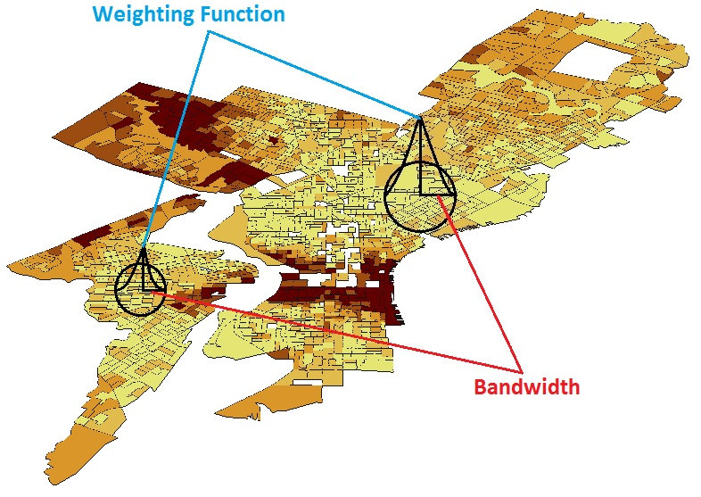
GWR Uses Nearby Observations

Slide 10
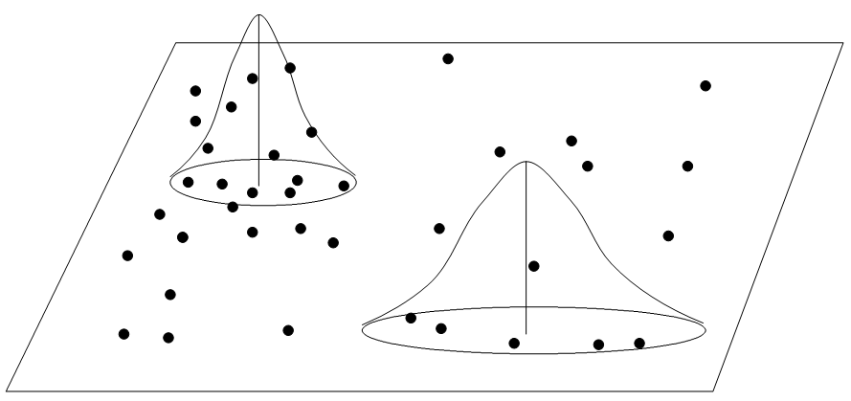
Similar Concept with Point Data
Weighting Function
Bandwidth
We will see later how to identify the appropriate bandwidth
Source: Yu, Wei, Presentation: Geographically Weighted Regression

Slide 11
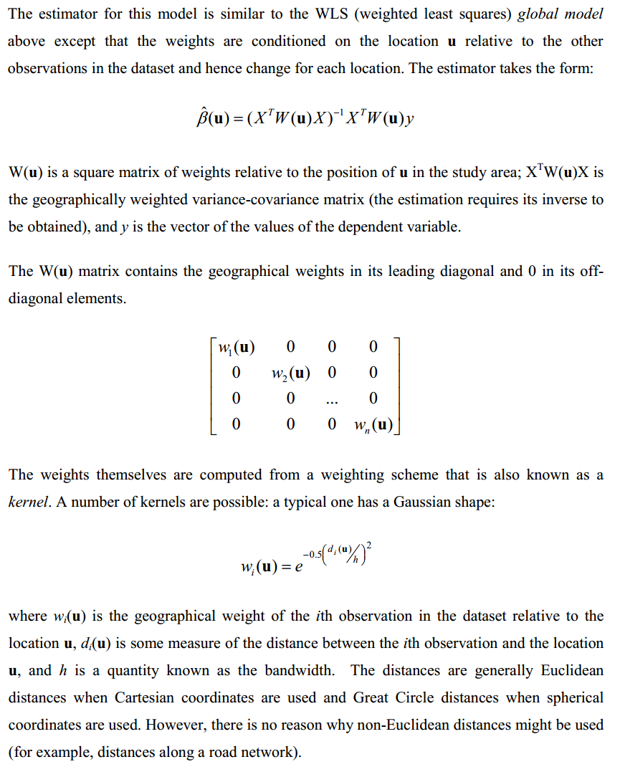
Parameter Estimation
Source: http://www.geos.ed.ac.uk/~gisteac/fspat/gwr/arcgis_gwr/GWR_WhitePaper.pdf

Slide 12
So How Do You Weigh Nearby Locations?
There are a couple ways:
Fixed bandwidth (kernel)
Variable bandwidth (kernel)
Kernel is a fancy way of saying “weighing function” and bandwidth is a fancy way of saying “distance”
Source: This slide and next few slides taken/adapted from: http://csde.washington.edu/services/gis/workshops/Resources/GWR_Presentation.pdf

Slide 13
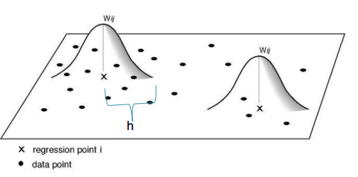
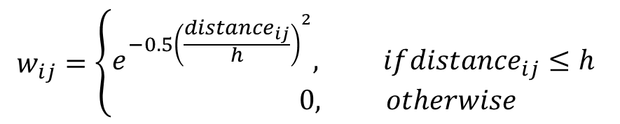

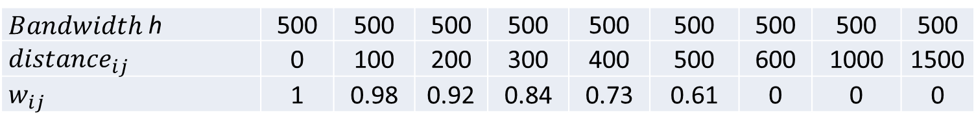

Fixed Bandwidth h
Number of observations will vary around each point i, but the bandwidth distance h (and the area) will remain constant.
${Distance}_{ij}$ is the distance between the regression point i and data point j.
$$w_{ij}=\left\{\begin{matrix}e^{−{0.5\left(\frac{{distance}_{ij}}{h}\right)}^{2}}, if{distance}_{ij}≤h \\ 0, otherwise\end{matrix}\right.$$
One way to define $w_{ij}$ is:
$Bandwidth$ h | 500 | 500 | 500 | 500 | 500 | 500 | 500 | 500 | 500
$${ distance}_{ij}$$ | 0 | 100 | 200 | 300 | 400 | 500 | 600 | 1000 | 1500
$${ w}_{ij}$$ | 1 | 0.98 | 0.92 | 0.84 | 0.73 | 0.61 | 0 | 0 | 0

Slide 14
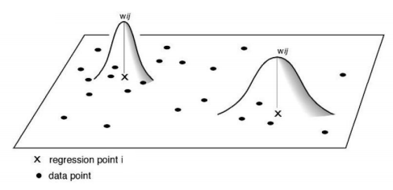

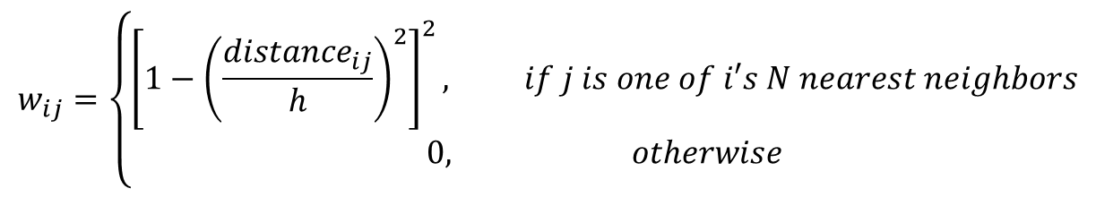
Adaptive Bandwidth h
Number of observations will remain fixed, but the area will not be the same
One way to define $w_{ij}$ is:
$$w_{ij}=\left\{\begin{matrix}\begin{aligned}{\left[1−{\left(\frac{{distance}_{ij}}{h}\right)}^{2}\right]}^{2}, if j is one of i′s N nearest neighbors \\ 0, otherwise\end{aligned} \\ \end{matrix}\right.$$
Note that in this formula h will vary from one observation to the next. Let’s assume we set N to 20 (i.e., for each observation we include 20 nearest neighbors in the regression). For observation 1, we may need to go out h = 5000 ft to get to the 20th neighbor, whereas for observation 2, we may only need to go out h = 2500 ft.

Slide 15
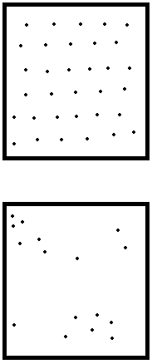
Fixed or Adaptive?
The assumptions you make about weights (i.e., bandwidth) greatly affect the results
Fixed bandwidth kernel will be more appropriate when the distribution of your observations is relatively stable across space (e.g., number of neighbors, size)
Adaptive bandwidth kernel is appropriate when distribution varies across space (i.e., events are clustered or polygons are heterogeneously shaped or sized)
Once a kernel type is selected, optimization takes some of the guesswork out of it, but robustness checks are still needed.
Use Fixed Bandwidth
Use Adaptive Bandwidth

Slide 16
Prior to Running GWR…
As with Spatial Lag and Spatial Error models, first run the OLS model to make sure that the model is reasonable, i.e., we have relationships which are worth exploring.
Very hard to check for linearity
If yes, then proceed to GWR to account for spatial autocorrelation and spatial non-stationarity.
Source: http://www.ucl.ac.uk/scs/people/academic-research-staff/spencer-chainey/Slides/NIJCMRC2011_GWR

Slide 17
Problem at Hand
In Philadelphia, do housing characteristics do a good job of predicting the number of college educated individuals living in a particular area (block group)?
Let’s regress our dependent variable, pctbachmor (# of individuals 25 years or older who have at least a bachelor’s degree), on:
pctvacant, % of housing units which are vacant
pctsingles, % of housing units which are single (non-attached) houses

Slide 18
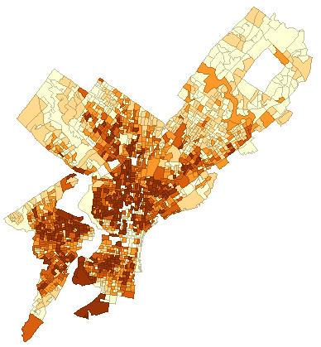
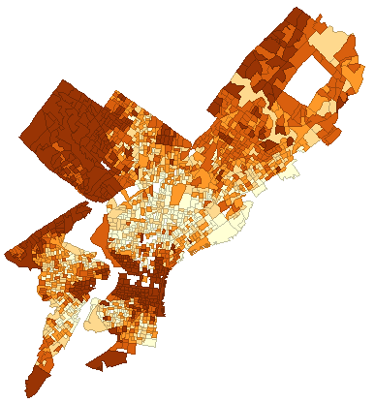
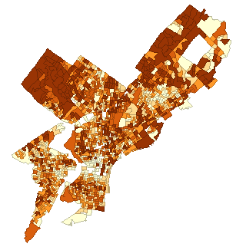
IV: PCTVACANT
DV: PCTBACHMORE
IV: PCTSINGLES

Slide 19
Let’s First Run OLS
Dependent Variable : PCTBACHMOR Number of Observations: 1720
Mean dependent var : 16.0814 Number of Variables : 3
S.D. dependent var : 17.7644 Degrees of Freedom : 1717
R-squared : 0.112782 F-statistic : 109.132
Adjusted R-squared : 0.111749 Prob(F-statistic) : 2.8026e-045
Sum squared residual: 481570 Log likelihood : -7286.44
Sigma-square : 280.472 Akaike info criterion : 14578.9**
S.E. of regression : 16.7473 Schwarz criterion : 14595.2
Sigma-square ML : 279.982 **AIC: Smaller is better.
S.E of regression ML: 16.7327
-----------------------------------------------------------------------
Variable Coefficient Std.Error t-Statistic Probability
-----------------------------------------------------------------------
CONSTANT 19.87546 0.7175294 27.69985 0.0000000
PCTVACANT -0.5070578 0.04244072 -11.94744 0.0000000
PCTSINGLES 0.2091645 0.03084245 6.78171 0.0000000
-----------------------------------------------------------------------
** THE WAY OF CALCULATING THE AIC IN ARCGIS IS ESSENTIALLY IDENTICAL.

Slide 20
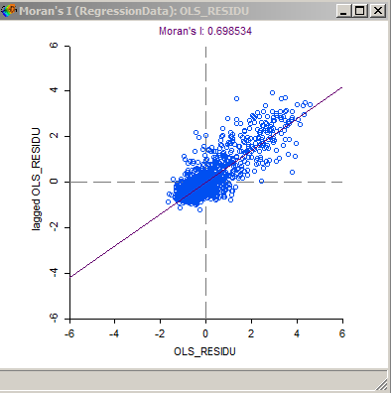
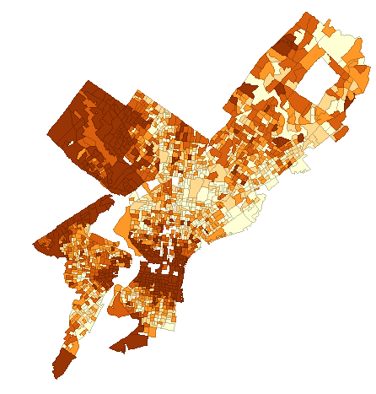
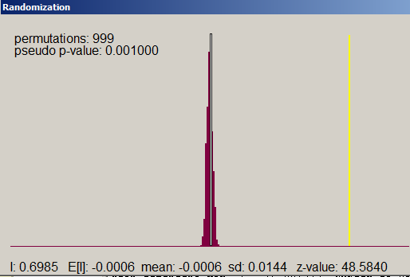
OLS Residuals
Queen Weight Matrix

Slide 21
Discussion of OLS Results
From the results, we see that even though the R² of the model is pretty low (0.11), both predictors are statistically significant (p<0.0001), and the overall model is significant also (F statistic = 109, p < 0.0001).
There is no multicollinearity here.
We’ll assume for the sake of the example that the assumptions of normality and heteroscedasticity are met.
Not really the case in practice if we look at the results of the Jarque-Bera normality of errors test, or the Breusch-Pagan test for heteroscedasticity.
Residuals are spatially autocorrelated, as indicated by the Moran’s I results.
Now, we need to take into account the spatial dependencies in the data.
Let’s use GWR! Recall: Use projected coordinate systems!

Slide 22
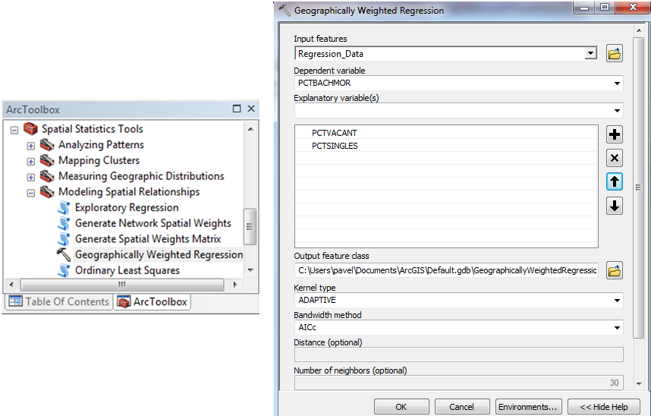
Let’s Run GWR In AcrMap…
Select Adaptive or Fixed
Select AIC, CV or Bandwidth_Parameter (manual)
ArcToolbox -> Spatial Statistics Tools -> Modeling Spatial Relationships -> Geographically Weighted Regression

Slide 23
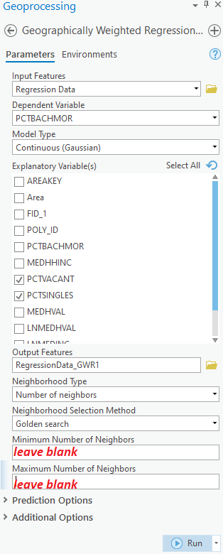
Let’s Run GWR In AcrGIS Pro…
In the Command Search window, type GWR…
Click Run!

Slide 24
Which Bandwidth Should We Pick?
If we’re dealing with the fixed bandwidth, we enter it into ArcGIS.
If we’re dealing with the adaptive bandwidth, we enter the number of nearest neighbors to be included.
Alternatively, we can let ArcGIS identify the best bandwidth (this is the best way of going about it)
ArcGIS lets us select whether we want to optimize model fit using the:
Akaike Information Criterion (AIC), same as in GeoDa. Smaller is better.
Cross Validation (CV), which chooses the bandwidth that minimizes the SSE (or RMSE) for GWR (see notes below this slide for more information).
Notes:
$$CV=\sum_{i}{{\left(y_{i}−{\hat{y}}_{≠i}(h)\right)}^{2}}$$
Here, ${\hat{y}}_{≠i}(h)$ is the fitted value of $y_{i}$ with data from point i omitted from the calibration and only points near to i are used. Lower values of CV indicate better model fits. This is, essentially, a way of calculating the SSE.
In English: for each observation i, run regression using ONLY nearby observations j within bandwidth h, but EXCLUDING i. Then, using the obtained Beta coefficients, calculate y-hat and residual for i. When we get the residuals for each i, we can compute the quantity for CV in the formula above (SSE), or the RMSE. We repeat this process for multiple bandwidths h and pick the model with the lowest CV score (i.e., lowest SSE or RMSE).
For more information on cross-validation in local regression, see:
Cleveland W.S. (1979). Robust Locally Weighted Regression and Smoothing Scatterplots. Journal of the American Statistical Association, 74: 829-36.
Brunsdon C., Fotheringham A.S. & Charlton M.E. (1996). Geographically Weighted Regression: A Method for Exploring Spatial Nonstationarity. Geographical Analysis, 28(4).

Slide 25
In ArcGIS Pro…
The Neighborhood Selection Method parameter specifies how the size of the neighborhood is determined (the actual distance or number of neighbors used). The neighborhood selected with the Golden search or Manual intervals option is always based on minimizing the value of the Akaike Information Criterion (AICc). Alternatively, you can set a specific neighborhood distance or number of neighbors with the User defined option.
When the Golden search option is chosen, the tool determines the best values for the Distance band or Number of neighbors parameter using the golden section search method. Golden search first finds maximum and minimum distances and tests the AICc at various distances incrementally between them. When there are more than 1000 features in a dataset, the maximum distance is the distance at which any feature has at most 1000 neighbors. The minimum distance is the distance at which every feature has at least 20 neighbors. If there are less than 1000 features, the maximum distance is the distance at which every feature has n/2 neighbors (half the number of features as neighbors), and the minimum distance is the distance at which every feature has at least 5 percent of n (5 percent of the features in the dataset as neighbors). Golden search determines the distance or number of neighbors with the lowest AICc as the neighborhood size.
You may get this warning
110306: The final model didn't have the lowest AICc encountered in the Golden Search Results:
The Golden Search algorithm is not guaranteed to find the lowest possible AICc for Number of neighbors or Distance band. One of the values in the Golden Search Results section of the geoprocessing messages had a lower AICc than the final value identified by Golden Search.
No action is required. However, consider running the tool again using the User defined option for Neighborhood Selection Method and providing the number of neighbors or distance band that corresponds to the lowest AICc.
https://pro.arcgis.com/en/pro-app/latest/tool-reference/spatial-statistics/how-geographicallyweightedregression-works.htm
https://pro.arcgis.com/en/pro-app/latest/tool-reference/tool-errors-and-warnings/110001-120000/tool-errors-and-warnings-110301-110325-110306.htm

Slide 26
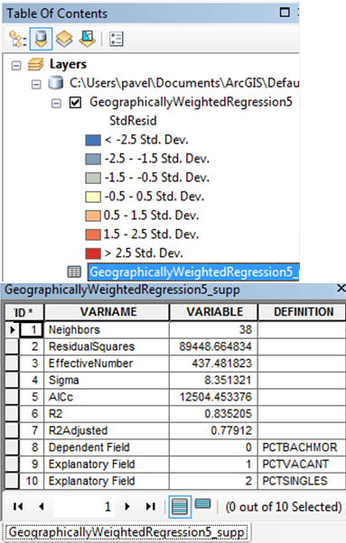
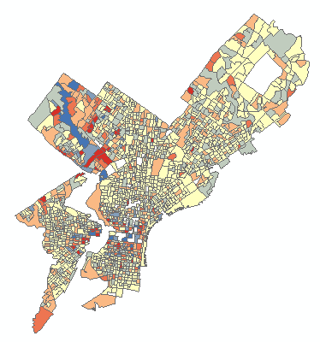
GWR Results
AIC: 12504.5; smaller than the 14578.9 value for OLS. GWR: better fit!

Slide 27
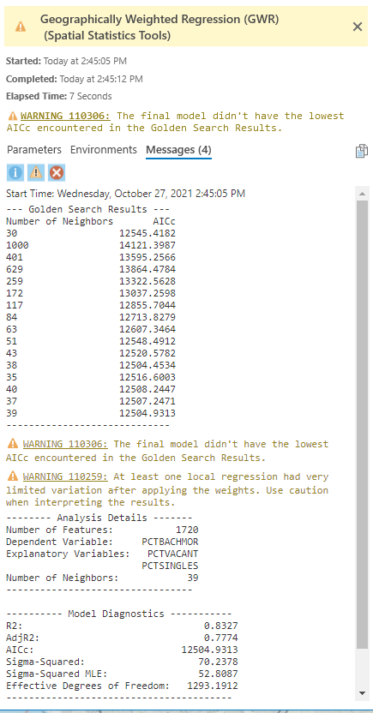
ArcGIS Pro Results
We can see that the results are a bit different here than in ArcMap. First of all, the number of neighbors is 39 rather than 38; secondly, there’s more information about the AIC.
This is because the Golden Search algorithm in ArcGIS Pro is slightly different than the AIC optimization algorithm in ArcMap.

Slide 28
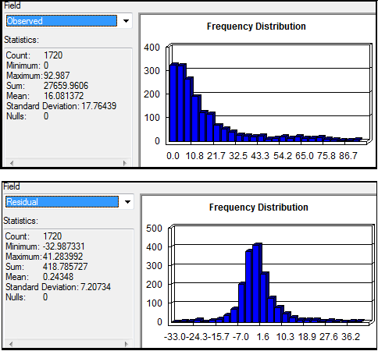
A Note on GWR Assumptions
A lot of the assumptions we have in OLS still hold in GWR.
Normality of residuals
Homoscedasticity
No multicollinearity (more on that later)
Here, dependent variable is not normal, but residuals seem close to normal-> we are probably ok.
GWR requires LOTS of observations (at least 300)!!

Slide 29
Making Sense of the GWR Output
The output consists of:
A map (and attribute table) which contains the regression standardized residuals and a bunch of other local statistics (for each observation)
GeographicallyWeightedRegression5.shp
A supplementary table which contains the overall (global) regression results
GeographicallyWeightedRegression5_Supp.shp
In ArcGIS Pro, this is the information that you can get in the messages tab of the GWR tool

Slide 30
First, Look at the Supplementary Table
Bandwidth or Neighbors: this is the bandwidth or number of neighbors used for each local estimation, and is perhaps the most important parameter for Geographically Weighted Regression.
The bandwidth units depend on the specified Kernel Type/Neighborhood Type.
If you select FIXED Kernel (or, in ArcGIS Pro, Neighborhood Type is Distance Band), the bandwidth value will reflect a distance in the same units as the input feature class (e.g., feet).
If you select ADAPTIVE Kernel (or, in ArcGIS Pro, Neighborhood Type is Number of Neighbors), the bandwidth distance will change according to the spatial density of features in input feature class.
The bandwidth becomes a function of the # of nearest neighbors such that each local estimation is based on the same # of features. Instead of a specific distance, the # of neighbors used for the analysis is reported.
Source for slides: http://resources.esri.com/help/9.3/arcgisdesktop/com/gp_toolref/spatial_statistics_tools/interpreting_gwr_results.htm

Slide 31
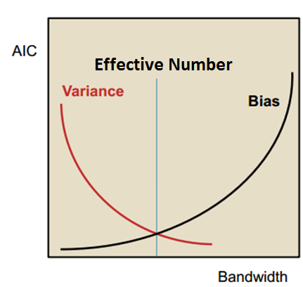
Supplementary Table (Cont’d)**
Effective Number: this value reflects a tradeoff between the variance of the fitted values and the bias* in the coefficient estimates, and is related to the choice of bandwidth.
As the bandwidth approaches infinity, the weights for every observation approach 1, and the coefficient estimates will be very close to those for a global OLS model.
For very large bandwidths, local coefficient estimates will have a small variance (i.e., they will all be quite similar to the global coefficient estimate); however, they will be biased.
Conversely, as the bandwidth approaches zero, the geographical weights for every observation approach zero with the exception of the regression point itself.
For extremely small bandwidths, the local coefficient estimates will have a large variance but low bias.
The effective number is used to compute a number of diagnostic measures.
*See next few slides
**Slides with read headings are optional

Slide 32
Bias, Efficiency, Consistency
This material is optional; moreover, we’ve talked about this when we covered Ridge & Lasso regression
In general, we aim to have unbiased, consistent and efficient estimators.
Different ways of parameter estimation (OLS, Maximum Likelihood, etc.) may yield parameter estimators with different levels of bias, consistency and efficiency.
For instance, going back to Spatial Lag and Spatial Error models, OLS estimation is replaced by maximum likelihood estimation because of these issues (e.g., bias) in OLS estimators for these models
http://diffuseprior.wordpress.com/2013/08/18/endogenous-spatial-lags-for-the-linear-regression-model/

Slide 33
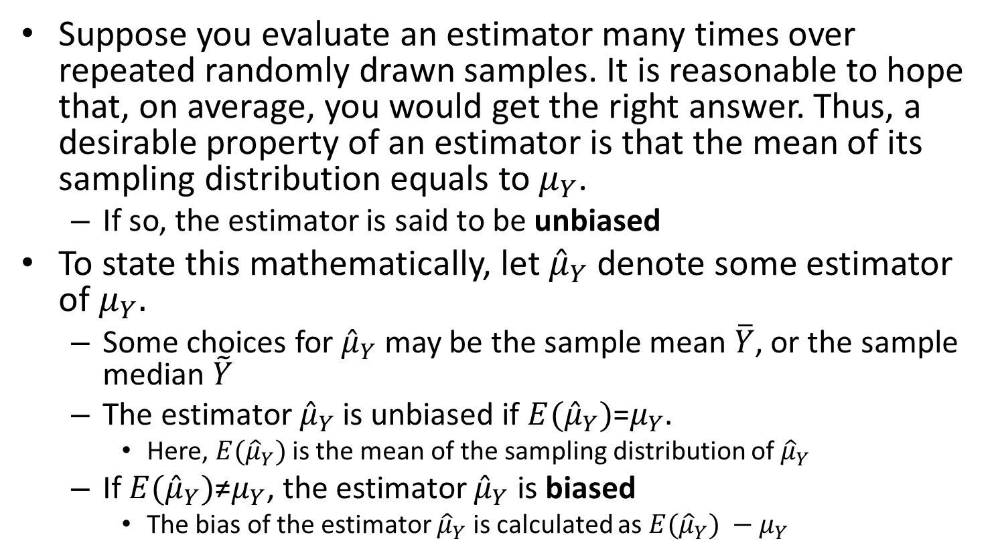
Bias
Suppose you evaluate an estimator many times over repeated randomly drawn samples. It is reasonable to hope that, on average, you would get the right answer. Thus, a desirable property of an estimator is that the mean of its sampling distribution equals to $μ_{Y}$.
If so, the estimator is said to be unbiased
To state this mathematically, let ${\hat{μ}}_{Y}$ denote some estimator of $μ_{Y}.$
Some choices for ${\hat{μ}}_{Y}$ may be the sample mean $\overline{Y}$, or the sample median $\tilde{Y}$
The estimator ${\hat{μ}}_{Y}$ is unbiased if ${E(\hat{μ}}_{Y})$=$μ_{Y}.$
Here, ${E(\hat{μ}}_{Y})$ is the mean of the sampling distribution of ${\hat{μ}}_{Y}$
If ${E(\hat{μ}}_{Y})$≠$μ_{Y}$, the estimator ${\hat{μ}}_{Y}$ is biased
The bias of the estimator ${\hat{μ}}_{Y}$ is calculated as ${E(\hat{μ}}_{Y}) −μ_{Y}$
Source: Stock & Watson, Introduction to Econometrics, 2003, pp. 57-58

Slide 34
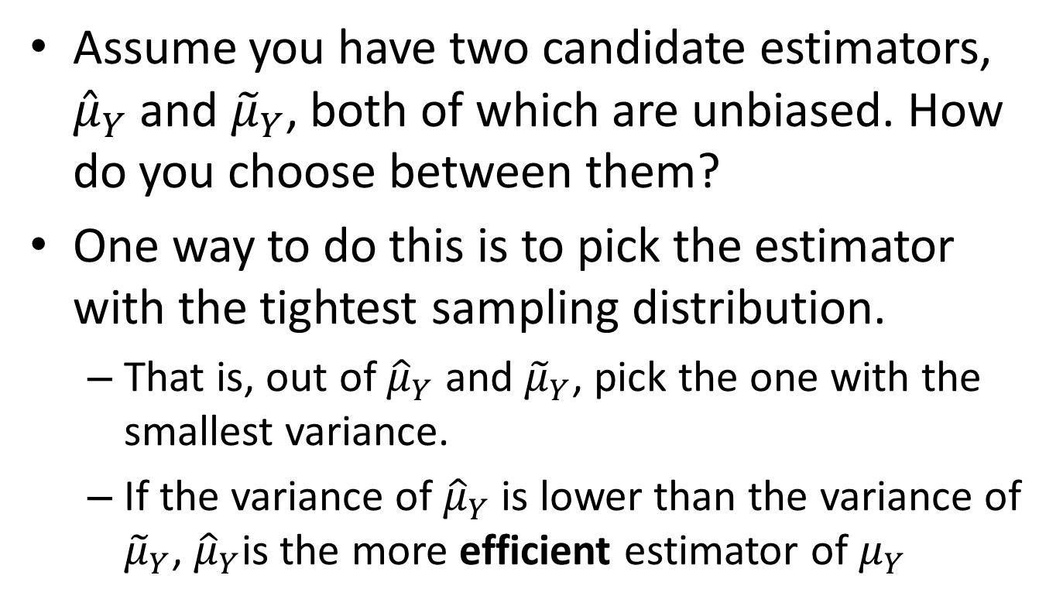
Variance and Efficiency
Assume you have two candidate estimators, ${\hat{μ}}_{Y}$ and ${\tilde{μ}}_{Y}$, both of which are unbiased. How do you choose between them?
One way to do this is to pick the estimator with the tightest sampling distribution.
That is, out of ${\hat{μ}}_{Y}$ and ${\tilde{μ}}_{Y}$, pick the one with the smallest variance.
If the variance of ${\hat{μ}}_{Y}$ is lower than the variance of ${\tilde{μ}}_{Y}$, ${\hat{μ}}_{Y}$is the more efficient estimator of $μ_{Y}$
Source: Stock & Watson, Introduction to Econometrics, 2003, pp. 57-58

Slide 35
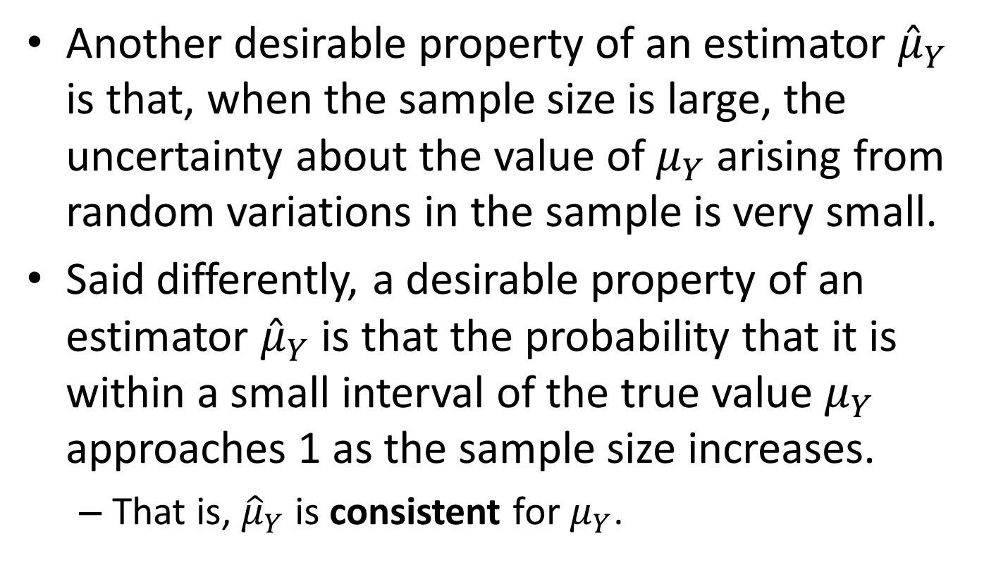
Consistency
Another desirable property of an estimator ${\hat{μ}}_{Y}$ is that, when the sample size is large, the uncertainty about the value of $μ_{Y}$ arising from random variations in the sample is very small.
Said differently, a desirable property of an estimator ${\hat{μ}}_{Y}$ is that the probability that it is within a small interval of the true value $μ_{Y}$ approaches 1 as the sample size increases.
That is, ${\hat{μ}}_{Y}$ is consistent for $μ_{Y}$.
Source: Stock & Watson, Introduction to Econometrics, 2003, pp. 57-58

Slide 36
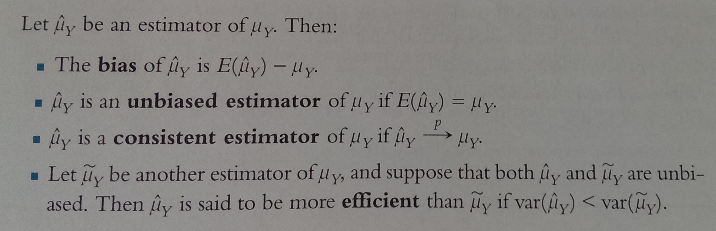
To Summarize…
Source: Stock & Watson, Introduction to Econometrics, 2003, p. 59

Slide 37
Supplementary Table (Cont’d)
Sigma
This is the estimated standard deviation for the residuals.
Smaller values of this statistic are preferable.
Sigma is used for AICc computations.
Mathematically, it is the square root of the normalized residual sum of squares where the residual sum of squares is divided by the effective degrees of freedom of the residual.
We won’t be looking at it in this course.

Slide 38
Supplementary Table (Cont’d)
AIC (Akaike Information Criterion)
This is a measure of model performance and is helpful for comparing different regression models.
Taking into account model complexity, the model with the lower AIC value provides a better fit to the observed data.
Again, AIC is not an absolute measure of goodness of fit, but is useful for comparing models with different explanatory variables as long as they apply to the same dependent variable.
If the AICc values for two models differ by more than 3, the model with the lower AICc is held to be better.
Comparing the GWR AIC value to the OLS AIC value is one way to assess the benefits of moving from a global model (OLS) to a local regression model (GWR).
GWR AIC: 12504; OLS AIC: 14578. Marked Reduction; GWR better.
Source for slides: http://resources.esri.com/help/9.3/arcgisdesktop/com/gp_toolref/spatial_statistics_tools/interpreting_gwr_results.htm

Slide 39
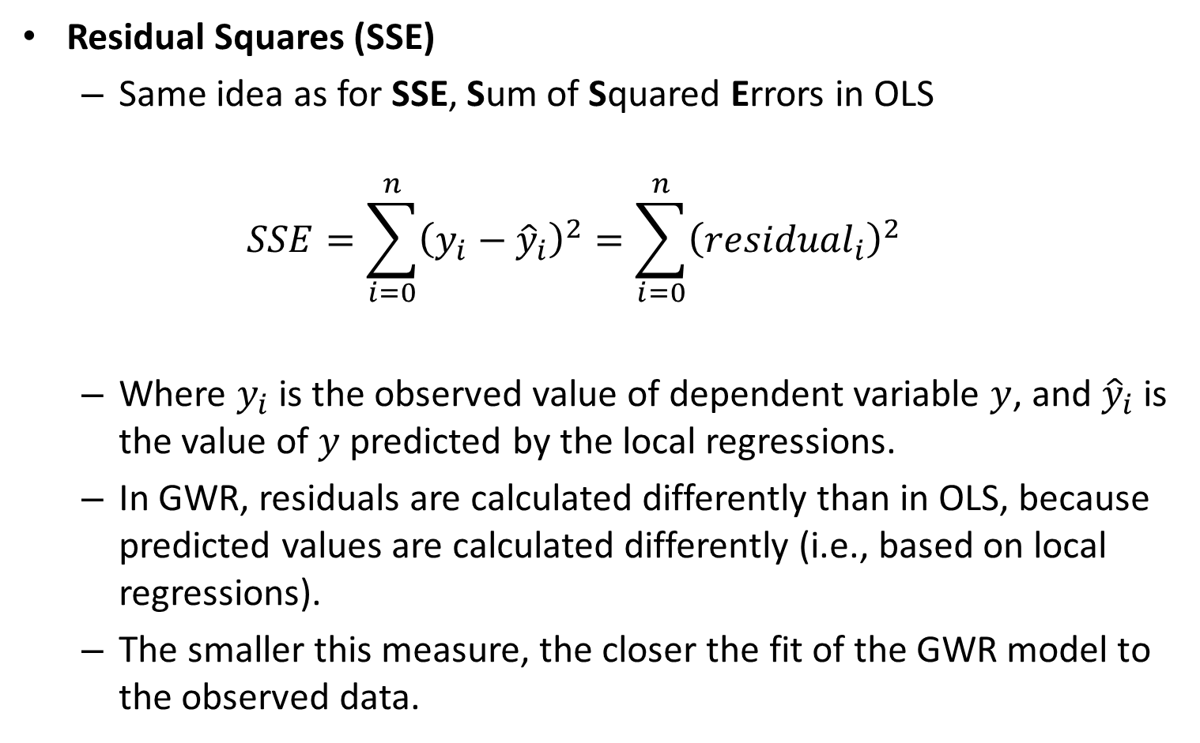
Supplementary Table (Cont’d)
Residual Squares (SSE)
Same idea as for SSE, Sum of Squared Errors in OLS
$$SSE=\sum_{i=0}^{n}{{\left(y_{i}−{\hat{y}}_{i}\right)}^{2}}=\sum_{i=0}^{n}{{\left({residual}_{i}\right)}^{2}}$$
Where $y_{i}$ is the observed value of dependent variable $y$, and ${\hat{y}}_{i}$ is the value of $y$ predicted by the local regressions.
In GWR, residuals are calculated differently than in OLS, because predicted values are calculated differently (i.e., based on local regressions).
The smaller this measure, the closer the fit of the GWR model to the observed data.

Slide 40
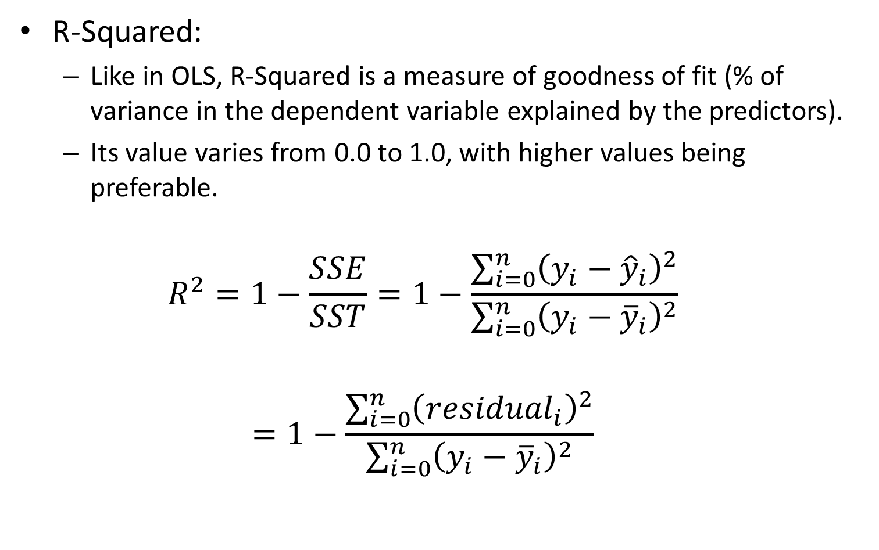
Supplementary Table (Cont’d)
R-Squared:
Like in OLS, R-Squared is a measure of goodness of fit (% of variance in the dependent variable explained by the predictors).
Its value varies from 0.0 to 1.0, with higher values being preferable.
$$R^{2}=1−\frac{SSE}{SST}=1−\frac{\sum_{i=0}^{n}{{\left(y_{i}−{\hat{y}}_{i}\right)}^{2}}}{\sum_{i=0}^{n}{{\left(y_{i}−{\overline{y}}_{i}\right)}^{2}}}$$
$$=1−\frac{\sum_{i=0}^{n}{{\left({residual}_{i}\right)}^{2}}}{\sum_{i=0}^{n}{{\left(y_{i}−{\overline{y}}_{i}\right)}^{2}}}$$

Slide 41
Supplementary Table (Cont’d)
R-Squared Adjusted:
Adjusts R-squared by the number of predictors in the model
Almost always smaller than the R-Squared model.
However, in making this adjustment, you lose the interpretation of the value as a proportion of the variance explained.
AICc are preferred to R-Squared and Adjusted R-Squared as a means of comparing models

Slide 42
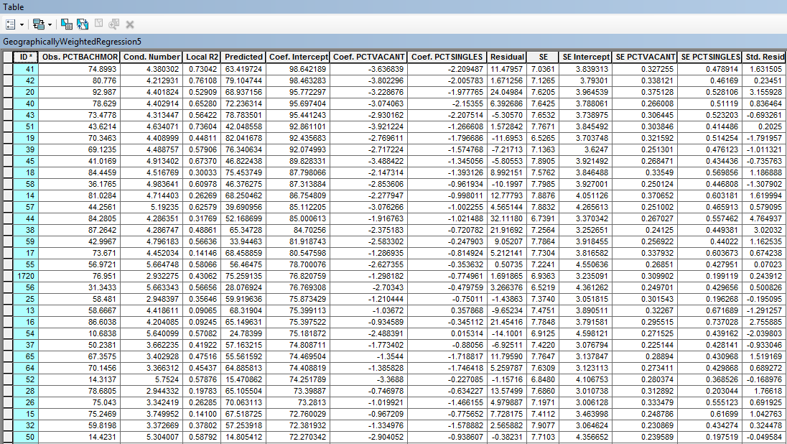
Attribute Table of GWR Results

Slide 43
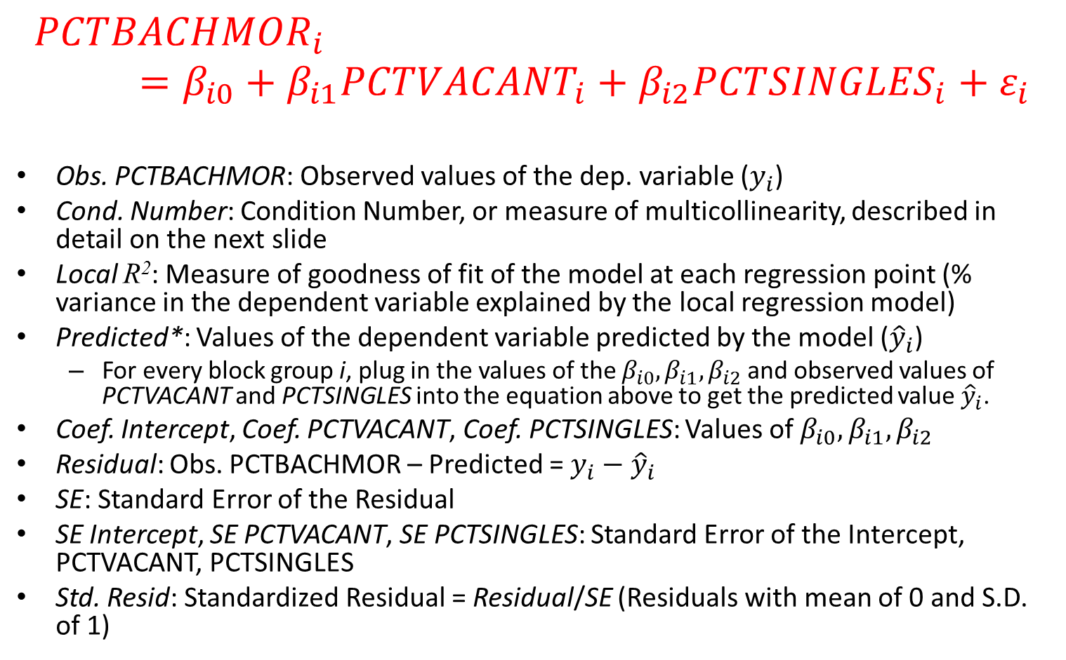
What Do Variables in the Attribute Table Mean?
$${PCTBACHMOR}_{i}=β_{i0}+β_{i1}{PCTVACANT}_{i}+β_{i2}{PCTSINGLES}_{i}+ε_{i}$$
Obs. PCTBACHMOR: Observed values of the dep. variable ($y_{i}$)
Cond. Number: Condition Number, or measure of multicollinearity, described in detail on the next slide
Local R²: Measure of goodness of fit of the model at each regression point (% variance in the dependent variable explained by the local regression model)
Predicted*: Values of the dependent variable predicted by the model (${\hat{y}}_{i}$)
For every block group i, plug in the values of the $β_{i0},β_{i1},β_{i2}$ and observed values of PCTVACANT and PCTSINGLES into the equation above to get the predicted value ${\hat{y}}_{i}$.
Coef. Intercept, Coef. PCTVACANT, Coef. PCTSINGLES: Values of $β_{i0},β_{i1},β_{i2}$
Residual: Obs. PCTBACHMOR – Predicted = $y_{i}−{\hat{y}}_{i}$
SE: Standard Error of the Residual
SE Intercept, SE PCTVACANT, SE PCTSINGLES: Standard Error of the Intercept, PCTVACANT, PCTSINGLES
Std. Resid: Standardized Residual = Residual/SE (Residuals with mean of 0 and S.D. of 1)
Notes:
See the Excel Spreadsheet

Slide 44
Multicollinearity/Clustering
In global regression models, such as OLS, results are unreliable when two or more variables exhibit multicollinearity.
That is, one of the variables is “redundant” because it tells the same story as the second one
GWR builds a local regression equation for each feature in the dataset. When the value for an explanatory variable cluster spatially in a substantial way, you will very likely have a problem.
That is, the variable tells the same story at every location (there’s not enough variability)
Also, you may have a problem with multicollinearity when you have 2+ variables that have similar patterns of clusters in a certain region
E.g., we may run into problems if we use two variables which both have very high (or very low) values at all locations in a certain part of the study region.
The condition number in the attribute table indicates when results are unstable due to local multicollinearity (field Cond. Number). As a rule of thumb, do not trust results for features with a condition number larger than 30; equal to Null; or equal to -1.7976931348623158e + 308.
There seem to be issues with some observations in this case!
Source: http://webhelp.esri.com/arcgisdesktop/9.3/index.cfm?TopicName=Geographically%20Weighted%20Regression%20(Spatial%20Statistics)

Slide 45
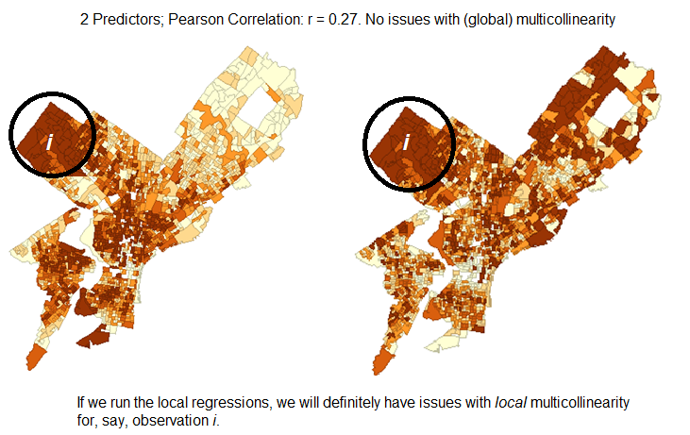
Local Multicollinearity: Similar patterns in 2+ predictors for some locations

Slide 46
A Note About Categorical and Dummy Predictors
Caution should be used when including nominal/categorical data in a GWR model. Where categories cluster spatially, there is strong risk of encountering local multicollinearity issues. Results in the presence of local multicollinearity are unstable, or models simply cannot be run.
Do not use "dummy" explanatory variables to represent different spatial regimes in a GWR model (e.g., block groups outside center city are assigned a value of 1, while all others are assigned a value of 0). Because GWR allows explanatory variable coefficients to vary, these spatial regime explanatory variables are unnecessary, and if included, will create problems with local multicollinearity
Source: http://resources.arcgis.com/en/help/main/10.1/index.html#//005p00000021000000

Slide 47
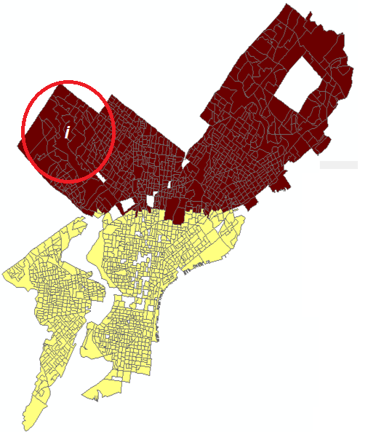
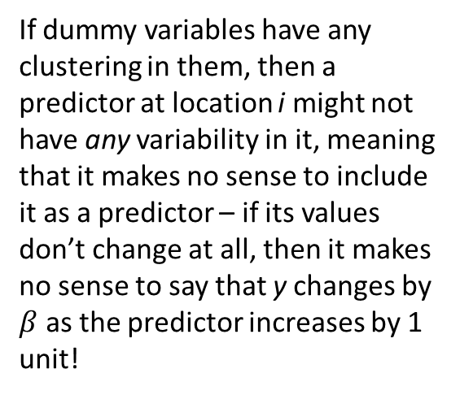
Problems with Dummy/Categorical Variables
If dummy variables have any clustering in them, then a predictor at location i might not have any variability in it, meaning that it makes no sense to include it as a predictor – if its values don’t change at all, then it makes no sense to say that y changes by $β$ as the predictor increases by 1 unit!

Slide 48
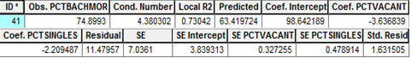
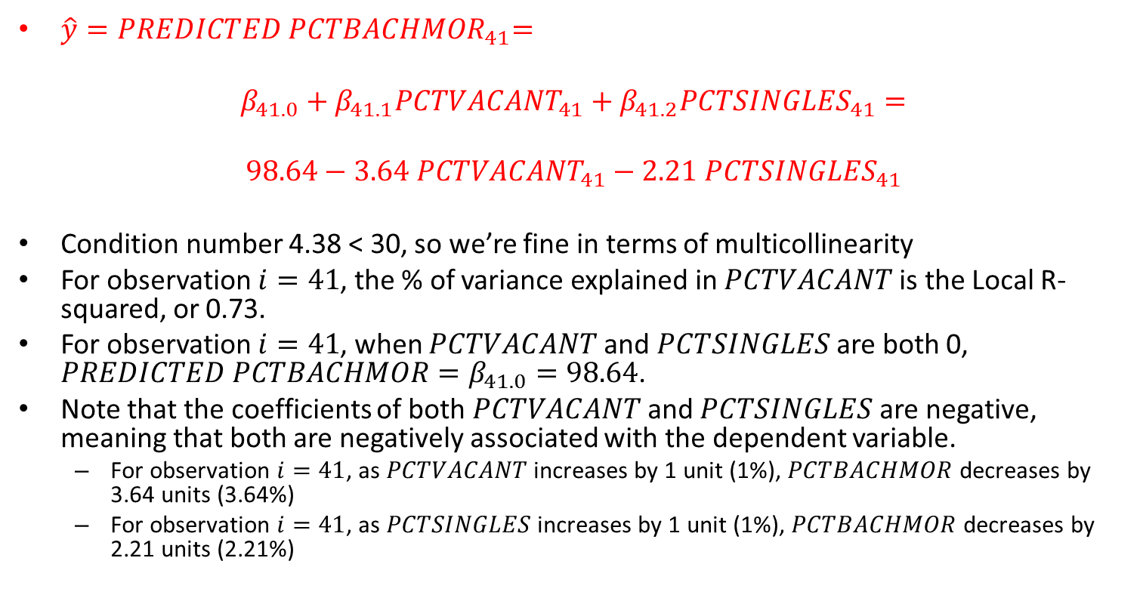
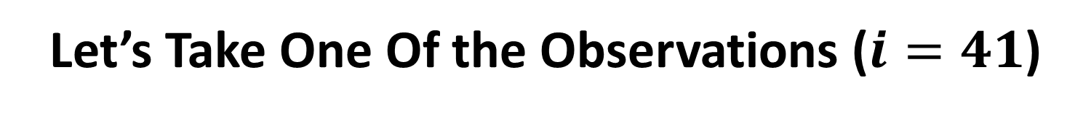
Let’s Take One Of the Observations ($i=41$)
$\hat{y}{=PREDICTED PCTBACHMOR}_{41}=$
$$β_{41.0}+β_{41.1}{PCTVACANT}_{41}+β_{41.2}{PCTSINGLES}_{41}=$$
$$98.64−3.64{ PCTVACANT}_{41}−2.21 {PCTSINGLES}_{41}$$
Condition number 4.38 < 30, so we’re fine in terms of multicollinearity
For observation $i=41$, the % of variance explained in $PCTVACANT$is the Local R-squared, or 0.73.
For observation $i=41$, when $PCTVACANT$ and $PCTSINGLES$ are both 0, $PREDICTED PCTBACHMOR=β_{41.0}=98.64$.
Note that the coefficients of both $PCTVACANT$ and $PCTSINGLES$ are negative, meaning that both are negatively associated with the dependent variable.
For observation $i=41$, as $PCTVACANT$ increases by 1 unit (1%), $PCTBACHMOR$decreases by 3.64 units (3.64%)
For observation $i=41$, as $PCTSINGLES$ increases by 1 unit (1%), $PCTBACHMOR$decreases by 2.21 units (2.21%)

Slide 49
But Where are the P-Values?
Recall that in a global model such as OLS it is usual to test whether the parameter estimates are significantly different from zero.
This can be accomplished with a t-test – the t statistics and their associated p-values are usually provided on the computer output.
The situation with GWR is a little more complex and is the subject of current research.
As there is one set of parameters associated with each regression point, as well as one set of standard errors, then there are potentially hundreds or thousands of tests that would be required to determine whether parameters are locally significant.
Recall the concept of type I error: if the α=0.05 significance level is used, we would expect 5 tests in every 100 to be significant when in reality they are not! (And we would also expect some significant results to be not significant when in reality they are – type II error).
With a 4 predictor model estimated at 2000 regression points, there would be 10000 significance tests (5 per point – 1 for the intercept and 4 for the predictors) would be we would expect 500 of these tests to return a significant result simply by chance (i.e., when they’re not significant in reality). This is the problem with multiple testing.
There are ways to adjust for multiple testing, but they are not currently implemented in ArcGIS
Source: http://www.geos.ed.ac.uk/~gisteac/fspat/gwr/arcgis_gwr/GWR_WhitePaper.pdf
Notes:
Draw on board.

Slide 50
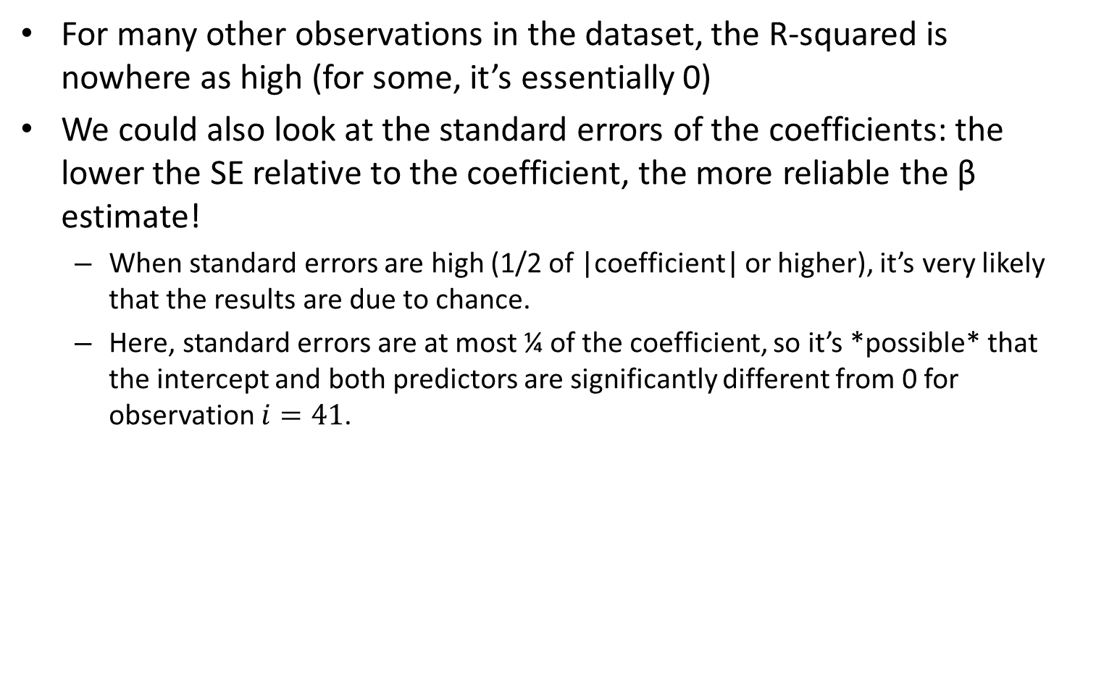
Some Notes on Local Results
For many other observations in the dataset, the R-squared is nowhere as high (for some, it’s essentially 0)
We could also look at the standard errors of the coefficients: the lower the SE relative to the coefficient, the more reliable the β estimate!
When standard errors are high (1/2 of |coefficient| or higher), it’s very likely that the results are due to chance.
Here, standard errors are at most ¼ of the coefficient, so it’s *possible* that the intercept and both predictors are significantly different from 0 for observation $i=41$.
 | Coefficient β | SE | (β/SE)**
Intercept | 98.64 | 3.84 | 25.67
PCTVACANT | -3.64 | 0.33 | -11.03
PCTSINGLES | -2.21 | 0.48 | -4.60
** This would be the t-statistic in a global model; t-statistics lower than 2 (or 1.96 when n is high) correspond to p-values > 0.05 (non-significant results).

Slide 51
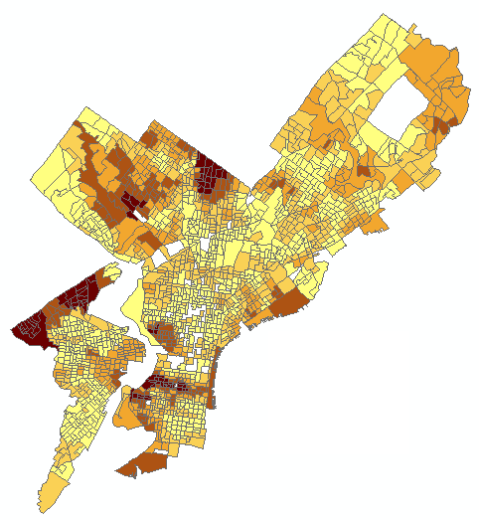
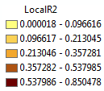
Let’s Map Some Local Statistics!
Note how much the R-squared varies throughout the city!
Lousy fit in most parts of Philadelphia, and very good fit in some others.

Slide 52
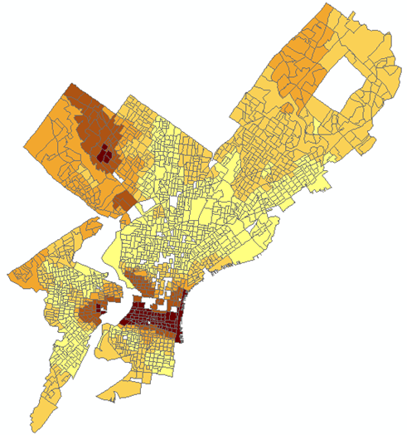
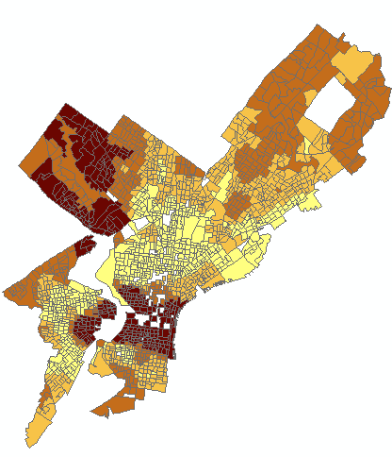
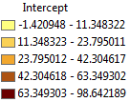
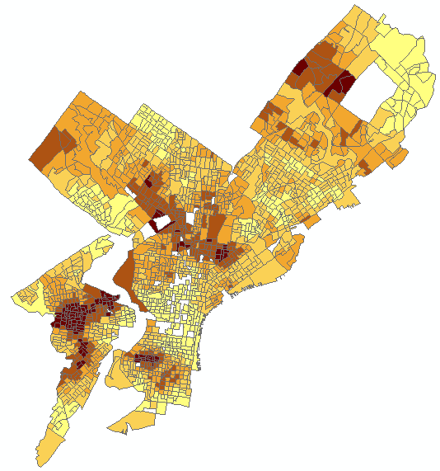
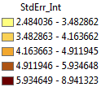
Intercept
Intercept/SE (darker values are very high values and are more “likely” to be significant)
In some parts of the city, the intercept is likely not significantly different from 0!

Slide 53
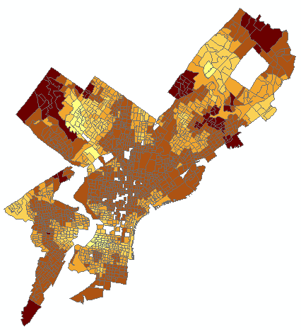
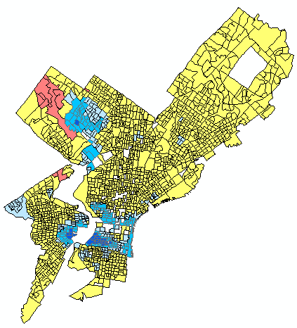
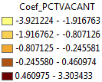


PCTVACANT
Coef_PCTVACANT/SE
The darker blue are very low values (possibly significant).
The pink are very high values (possibly significant)

Slide 54





PCTSINGLES
Coef_PCTSINGLES/SE
The darker blue are very low values (possibly significant).
The darker red are very high values (possibly significant)

Slide 55
A Note on Presenting Coef/SE Results
When we present the spatial distribution of Coefficient/SE, we may wish to have the following breaks and color schemes:
Coef/SE <= -2: A negative relationship with the dependent variable that’s possibly significant
Dark Blue
- 2 < Coef/SE <= 0: A negative relationship with the dependent variable that’s likely not significant
Light Blue
0 < Coef/SE < 2: A positive relationship with the dependent variable that’s likely not significant
Pink
Coef/SE >= 2: A positive relationship with the dependent variable that’s possibly significant
Dark Red

Slide 56


Slide 57


Slide 58
Going Over Results On Previous Slides
Examine the maps on the previous slides to better understand regional variation in the model explanatory variables.
We are interested in examining how spatially consistent (stationary) relationships between the dependent variable and each explanatory variable are across the study area.
Examining the coefficient distribution as a surface shows where and how much variation is present. You can use your understanding of this variation to inform policy.
In general:
Statistically significant global variables that exhibit little regional variation inform region wide policy.
Statistically significant global variables that exhibit strong regional variation inform local policy: This is what we have here!
Some variables may not be globally significant, because in some regions they are positively related and others they are negatively related: This is what we have here!
Vast spatial variation in coefficient estimates may mean that important predictors are omitted from the model (e.g., median house value; median household income)
Source: http://webhelp.esri.com/arcgisdesktop/9.3/index.cfm?TopicName=Interpreting_GWR_results

Slide 59




Are Residuals Spatially Autocorrelated?
Bring GeographicallyWeightedRegression5.shp into GeoDa and look at Moran’s I.

Slide 60

Let’s Run GWR with Other Specs!

Slide 61
Compare to Spatial Lag Regression
Data set : Regression_Data
Spatial Weight : Regression_Data.gal (QUEEN)
Dependent Variable : PCTBACHMOR Number of Observations: 1720
Mean dependent var : 16.0814 Number of Variables : 4
S.D. dependent var : 17.7644 Degrees of Freedom : 1716
Lag coeff. (Rho) : 0.855864
R-squared : 0.748861 Log likelihood : -6365.78
Sq. Correlation : - Akaike info criterion : 12739.6
Sigma-square : 79.2529 Schwarz criterion : 12761.4
S.E of regression : 8.90241
-----------------------------------------------------------------------
Variable Coefficient Std.Error z-value Probability
-----------------------------------------------------------------------
W_PCTBACHMOR 0.8558641 0.01303343 65.66682 0.0000000
CONSTANT 3.458982 0.4646148 7.44484 0.0000000
PCTVACANT -0.1615949 0.02346059 -6.887933 0.0000000
PCTSINGLES 0.08481998 0.01661929 5.103707 0.0000003
-----------------------------------------------------------------------

Slide 62




Spatial Lag Residuals

Slide 63
Compare to Spatial Error Regression
Data set : Regression_Data
Spatial Weight : Regression_Data.gal (QUEEN)
Dependent Variable : PCTBACHMOR Number of Observations: 1720
Mean dependent var : 16.081372 Number of Variables : 3
S.D. dependent var : 17.764392 Degrees of Freedom : 1717
Lag coeff. (Lambda) : 0.871578
R-squared : 0.747183 R-squared (BUSE) : -
Sq. Correlation : - Log likelihood :-6381.287403
Sigma-square : 79.7824 Akaike info criterion : 12768.6
S.E of regression : 8.9321 Schwarz criterion : 12784.9
-----------------------------------------------------------------------
Variable Coefficient Std.Error z-value Probability
-----------------------------------------------------------------------
CONSTANT 17.82738 1.723023 10.34657 0.0000000
PCTVACANT -0.1628771 0.02833427 -5.748414 0.0000000
PCTSINGLES 0.08879694 0.01957964 4.535168 0.0000058
LAMBDA 0.8715781 0.01303607 66.85895 0.0000000
-----------------------------------------------------------------------

Slide 64




Spatial Error Residuals

Slide 65
Is GWR Better than Other Models Here?
Seems that GWR is a better model than OLS
Accounts for potential spatial non-stationarity
Yields a better fit (lower AIC; better R-squared)
GWR with different specs still yield lower AICs than OLS
No spatial autocorrelation in residuals in GWR, but spatial autocorrelation in OLS
Seems that GWR is a better model than SE and SL
Lower AIC
No spatial autocorrelation in residuals in GWR, but a little spatial autocorrelation left in residuals in SE and SL

Slide 66
In R
Data set: LondonWards.csv
625 wards
Each ward has an x and y coordinate which may be plotted
Regress: Emloyment Rate (EmpRate) on
House Price (HousePri)
Mean Age (MeanAge)
Percent of Foreign Born Residents (PerForeign)
In addition, we also have a polygon shapefile of London Boroughs (which are larger than wards)

Slide 67
In R (Cont’d)
#Code adapted from the GWR in R Instructions:
#https://rstudio-pubs-static.s3.amazonaws.com/44975_0342ec49f925426fa16ebcdc28210118.html
install.packages("maptools")
install.packages("spdep")
install.packages("spgwr")
install.packages("rgdal")
install.packages("ggplot2")
install.packages("rgeos")
install.packages("ape")
library(maptools)
library(spdep)
library(spgwr)
library(rgdal)
library(ggplot2)
library(rgeos)
library(ape)

Slide 68

In R (Cont’d)
setwd("C:/Users/eugeneby/Dropbox/Documents/Work and School/Teaching/CPLN 671 - Statistics and Data Mining/Data/GWR")
LondonWards <-read.csv("LondonData.csv")
attach(LondonWards)
head(LondonWards)

Slide 69

In R (Cont’d)

Slide 70


In R (Cont’d)

Slide 71

In R (Cont’d)

Slide 72

In R (Cont’d)

Slide 73

In R (Cont’d)

Slide 74


In R (Cont’d)

Slide 75


In R (Cont’d)

Slide 76


In R (Cont’d)

Slide 77

In R (Cont’d)

Slide 78

In R (Cont’d)

